Slide 1
Fixed Mindset vs.
Growth Mindset
Tiffany Schuette – Elementary School Counselor
Casey Mertens – Middle School Counselor
New Holstein School District
Notes:
Introductions
(Tiffany)

Slide 2
Topics to Discuss
What is a Mindset
Fixed Mindset
Growth Mindset
Steps to a Growth Mindset
What you can do…
Notes:
Casey
What we’ll discuss with you today is the meaning of a mindset,
Where the research and idea stems from,
What are fixed vs. growth mindsets,
Steps towards developing a growth mindset
And what you can do as a counselor

Slide 3
What is a Mindset?
Definition on a Mindset:
  the established set of attitudes or beliefs held by someone
Notes:
Casey
Summarize:

Slide 4
What is a Mindset?
Mindset is a simple idea discovered by world-renowned Stanford University psychologist Carol Dweck in decades of research on achievement and success—a simple idea that makes all the difference.
Every so often a truly groundbreaking idea comes along. This is one. Mindset explains:
  Why brains and talent don’t bring success
  How they can stand in the way of it
  Why praising brains and talent doesn’t foster self-esteem and accomplishment, but jeopardizes them
  How teaching a simple idea about the brain raises grades and productivity
  What all great CEOs, parents, teachers, athletes know
      http://mindsetonline.com/whatisit/about/
Notes:
Casey

Slide 5
What is a Fixed Mindset?
In a fixed mindset people believe their basic qualities, like their intelligence or talent, are simply fixed traits.
They spend their time documenting their intelligence or talent instead of developing them.
They also tend to believe that talent alone creates success – without effort. They are wrong
      http://mindsetonline.com/whatisit/about/
Notes:
Casey
Their traits are simply given to them and there’s nothing they can do to improve them.
What we might hear students say if they have a fixed mindset is: I’m not doing well in math because I was never good at it and I never will be.

Slide 6
Fixed Mindset: Intelligence is Static
Leads to a desire to look smart and therefore have a tendency to:
  Avoid challenges
  Gives up too easily
  Views effort as fruitless or worse
  Ignores useful criticism
  Feel threatened by the success of others
      http://michaelgr.com/2007/04/15/fixed-mindset-vs-growth-mindset-which-one-are-you/
Notes:
Casey
As counselors, we see these things from our fixed mindset students:
I’m just not good at math
I’m afraid to fail
They might speak bad about their peers out of jealousy

Slide 7
What is a Growth Mindset?
In a growth mindset, people believe that their most basic abilities can be developed through dedication and hard work – brains and talent are just the starting point.
This view creates a love of learning and a resilience that is essential for great accomplishment.
Virtually all great people have had these qualities. http://mindsetonline.com/whatisit/about/
Notes:
Tiffany
Mention Famous Failures such as: Thomas Edison, Michael Jordan, Steve Jobs, Albert Einstein etc.
These people are great because they had a growth mindset.

Slide 8
Growth Mindset: Intelligence can be Developed
Lead to a desire to learn and therefore a tendency to:
  Embrace challenges
  Persist in the face of setbacks
  See effort as the path to mastery
  Learn from criticism
  Finds lessons and inspiration in the success of others.
      http://michaelgr.com/2007/04/15/fixed-mindset-vs-growth-mindset-which-one-are-you/
Notes:
Tiffany

Slide 9
Salman Khan – Why I’ll Never Tell My Son He’s Smart
https://www.youtube.com/watch?v=JC82Il2cjqA
Quote from Sal Khan
Notes:
Tiffany- Explain Sal Khan and Khan Academy with gifted kids
Read Quote below from Salman Khan’ Article:
‘My 5-year-­old son has just started reading. Every night, we lie on his bed and he reads a short book to me. Inevitably, he’ll hit a word that he has trouble with: last night the word was “gratefully.” He eventually got it after a fairly painful minute. He then said, “Dad, aren’t you glad how I struggled with that word? I think I could feel my brain growing.” I smiled: my son was now verbalizing the tell­-tale signs of a “growth­ mindset.” ‘
The article goes on to state that:
The brain is like a muscle, the more you use it the more it grows
That our intelligence is not fixed, and the best way that we can grow our intelligence is to embrace tasks where we might struggle and fail.
The research shows that just being exposed to the research itself (­­for example, knowing that the brain grows most by getting questions wrong, not right­­) can begin to change a person’s mindset. The second half of the intervention is for you to communicate the research with others.
I have Sal Khan’s article accessible for you and other materials as well. I will show you how to access them later.
Here is the video Sal Khan created.
Show video

Slide 10
Growth Mindset
As a result, they reach ever-higher levels of achievement and a greater sense of free will
Growth mindset individuals will improve and this will create positive feedback loops that encourage them to keep learning and improving.
Notes:
Tiffany
So, for kids or adults that are in a growth mindset…

Slide 11
Eduardo Briceno - TEDX
https://www.youtube.com/watch?v=pN34FNbOKXc
Notes:
Tiffany – In the video he talks about the growth mindset.
Show 3 minutes or so.

Slide 12
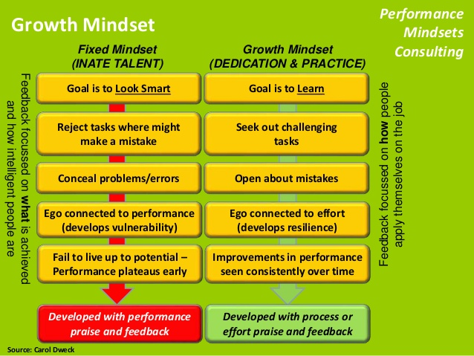
What the experts think
Notes:
Casey
Mention Carol Dweck

Slide 13
The Idea In Practice
https://www.youtube.com/watch?v=PUKe55aZaYQ
The Candle Problem
Notes:
Casey
We have an experiment to test our mindset right here right now:
Show clip through second 20
Stop and ask if anyone who hasn’t previously done this experiment knows the solution

Slide 14
What Now?
A fixed mindset can be changed to a growth mindset.
Experts believe that fixed vs. growth mindset should be taught to all children.
      http://michaelgr.com/2007/04/15/fixed-mindset-vs-growth-mindset-which-one-are-you/
Notes:
Tiffany

Slide 15
Changing From a Fixed Mindset to a Growth Mindset
Step 1: Learn to hear you fixed mindset “voice.”
As you approach a challenge, that voice might say to you “Are you sure you can do it? Maybe you don’t have the talent.” “What if you fail—you’ll be a failure” “People will laugh at you for thinking you had talent.” “If you don’t try, you can protect yourself and keep your dignity.”
As you hit a setback, the voice might say, “This would have been a snap if you really had talent.” “You see, I told you it was a risk. Now you’ve gone and shown the world how limited you are.” “ It’s not too late to back out, make excuses, and try to regain your dignity.”
As you face criticism, you might hear yourself say, “It’s not my fault. It was something or someone else’s fault.” You might feel yourself getting angry at the person who is giving you feedback. “Who do they think they are? I’ll put them in their place.” The other person might be giving you specific, constructive feedback, but you might be hearing them say “I’m really disappointed in you. I thought you were capable but now I see you’re not.”
http://mindsetonline.com/changeyourmindset/firststeps/
Notes:
Tiffany

Slide 16
Changing From a Fixed Mindset to a Growth Mindset
Step 2: Recognize that you have a choice
How you interpret challenges, setbacks, and criticism is your choice. You can interpret them in a fixed mindset as signs that your fixed talents or abilities are lacking. Or you can interpret them in a growth mindset as signs that you need to ramp up your strategies and effort, stretch yourself, and expand your abilities. It’s up to you.
So as you face challenges, setbacks, and criticism, listen to the fixed mindset voice and...
Notes:
Tiffany

Slide 17
Changing From a Fixed Mindset to a Growth Mindset
Step 3. Talk back to it with a growth mindset voice.
As you approach a challenge:
THE FIXED-MINDSET says “Are you sure you can do it? Maybe you don’t have the talent.”
THE GROWTH-MINDSET answers, “I’m not sure I can do it now, but I think I can learn to with time and effort.”
FIXED MINDSET: “What if you fail—you’ll be a failure”
GROWTH MINDSET: “Most successful people had failures along the way.”
FIXED MINDSET: “If you don’t try, you can protect yourself and keep your dignity.”
GROWTH MINDSET: “If I don’t try, I automatically fail. Where’s the dignity in that?”
Notes:
Casey

Slide 18
Changing From a Fixed Mindset to a Growth Mindset
Step 3 Continued…
As you hit a setback:
FIXED MINDSET: “This would have been a snap if you really had talent.”
GROWTH MINDSET: “That is so wrong. Basketball wasn’t easy for Michael Jordan and science wasn’t easy for Thomas Edison. They had a passion and put in tons of effort.
As you face criticism:
FIXED MINDSET: “It’s not my fault. It was something or someone else’s fault.”
GROWTH MINDSET: “If I don’t take responsibility, I can’t fix it. Let me listen—however painful it is– and learn whatever I can.”
Notes:
Casey

Slide 19
Changing From a Fixed Mindset to a Growth Mindset
Step 4. Take the growth mindset action.
Over time, which voice you heed becomes pretty much your choice. Whether you
  take on the challenge wholeheartedly,
  learn from your setbacks and try again
  hear the criticism and act on it is now in your hands.
Practice hearing both voices, and practice acting on the growth mindset. See how you can make it work for you.
Notes:
Casey

Slide 20
A Growth Mindset: What you can do
Help Students, Staff, Administration, and Parents understand what a growth mindset is
Teach students about the Mindsets and the four steps on how to change from a fixed to a growth mindset.
See example lesson appropriate for Grades Kindergarten through 8th Grade.
Notes:
Tiffany

Slide 21
A Growth Mindset: What you can do
Keep doing what you are doing!
  As School Counselors we motivate and encourage students in Classroom Guidance Lessons.
Build Rapport and relationships with Parents:
  Post Fixed vs. Growth information on your webpage
  Present to staff
  Present to PTO
  Post an article to the school newsletter
Notes:
Tiffany – Mention educating students.

Slide 22
Elementary Level Lesson
How to access all materials:
  Google: New Holstein School District
  Click on Elementary School
  Click on Staff Listing
  Under Last Name Contains: enter Schuette
  Click on Web site
  On the left side click on WSCA Conference Attendees
Notes:
Tiffany
Explain where to find materials on Tiffany’s website
Pass out small papers with directions…

Slide 23
Middle/High School Level
Small Groups focused on a Growth Mindset
The 7 Habits of Highly Effective Teens by Sean Covey
  Teaches HOW to make the change towards a growth mindset
  http://www.franklincovey.com/tc/mediaengine/public/files/ss_7ht_uag_sample.pdf
Notes:
Casey
Small groups could focus on self-esteem or self-confidence especially since it’s know that middle school girls have a reputation to lose self-esteem when they hit puberty.

Slide 24
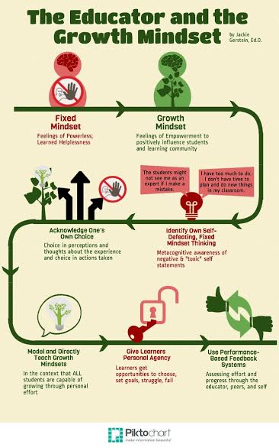
Educator Mindsets
Notes:
Casey

Slide 25
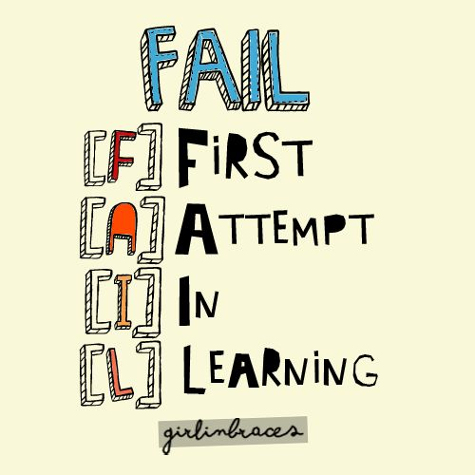
Questions?
Tiffany Schuette
Elementary School Counselor
New Holstein School District
(920) 898-4208
tschuette@nhsd.k12.wi.us
Casey Mertens
Middle School Counselor
New Holstein School District
(920) 898-4769
cmertens@nhsd.k12.wi.us

